Slide 1
Data Science Final Project
Team 3
Loan Default Case

Slide 2
Business Understanding/Deployment
Goal: Maximize Profit for a Bank
Ideas to Proceed?
Identify the customers who are most likely to default.
Choose a threshold that will help banks to maximize profit
Deployment
Providing the tool/model that will help banks screen customers more efficiently
2

Slide 3
Data Understanding/Preparation
122 features (number of original features) ; 54 features (post-cleaning)
307,511 observations (number of customers in the dataset); 182,322 observations (post cleaning)
Target Variable:
Defaulter (yes/no)
Features/Attributes:
Demographics( gender/ age/ family status, etc)
Financial Standing (income, previous loan history, loan amount requested)

Slide 4
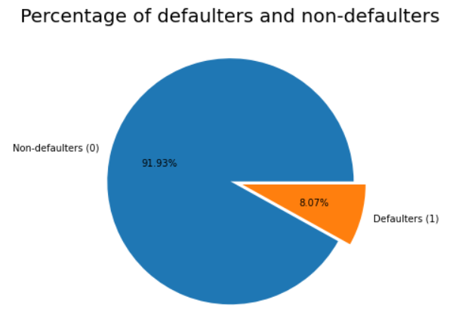
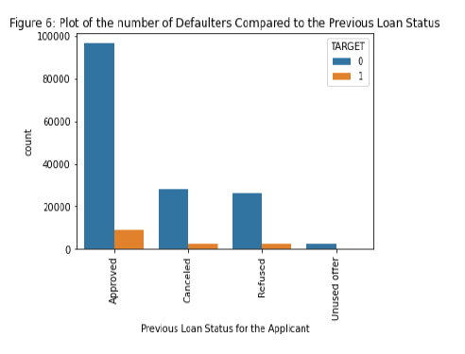
Exploratory Data Analysis

Slide 5
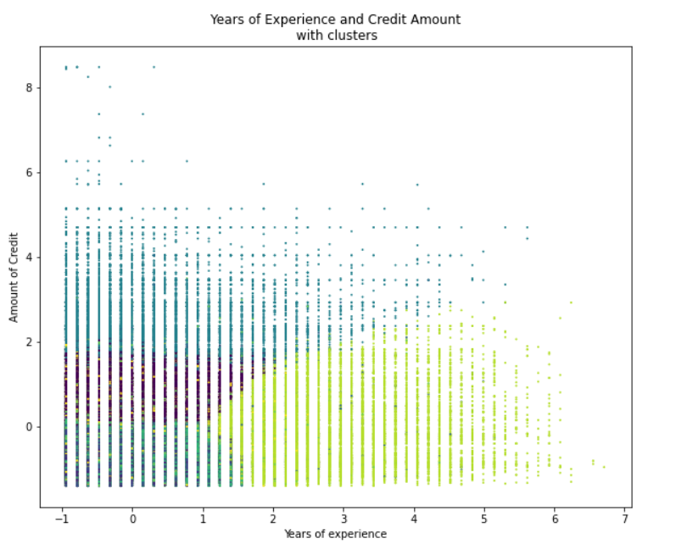
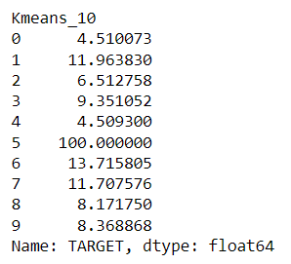
Kmeans Clustering
Average number of defaulters within clusters

Slide 6
Modeling
Determine the likelihood that a customer will default
Which core data mining task?
* Classification
Which data mining method?
Logistic Regression with Lasso
Random Forest
Gradient Boosting Classifier
XGBoost Classifier
Performance Metric to consider:
1. Accuracy
2. AUC
3. Profit Maximization

Slide 7
Steps and Evaluation
Hyper Parameter Tuning : Grid Search Cross Validation
Modelling using the best parameters.
Cross Validation in the training dataset.
Holdout 34,000 sample of observations.

Slide 8
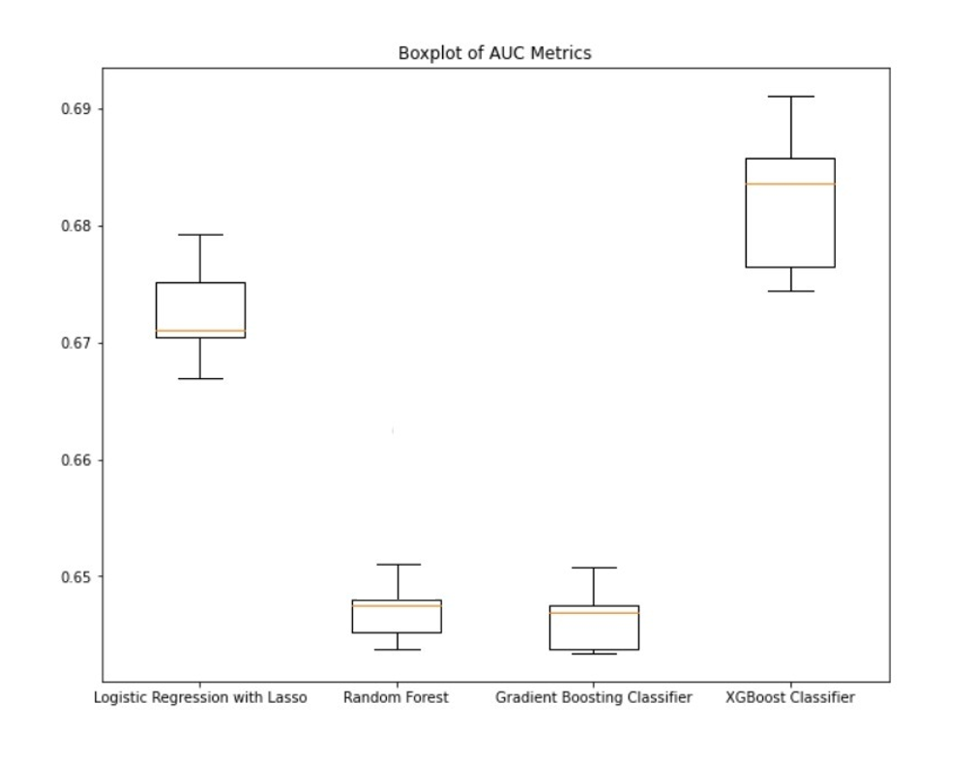
Evaluation: Cross Validation
Hence, we will choose XGBoost Classifier model

Slide 9
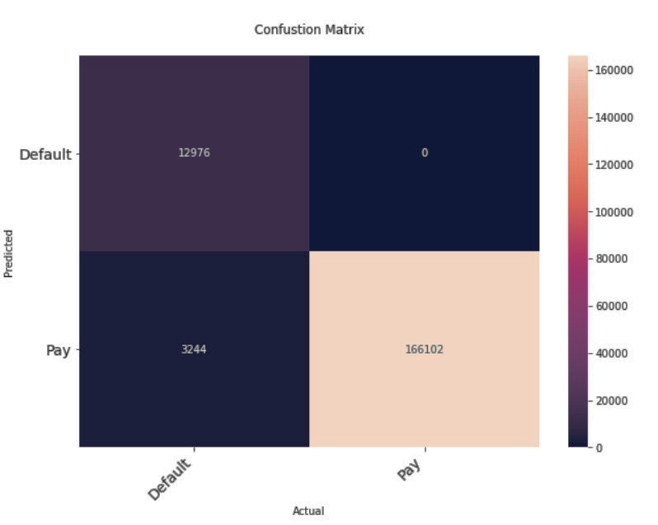
Model Performance: Confusion Matrix
True positive rate and false positive rate:
𝐹𝑎𝑙𝑠𝑒 𝑝𝑜𝑠𝑖𝑡𝑖𝑣𝑒 𝑟𝑎𝑡𝑒 = 0/(0+166102) = 0%.
𝑇𝑟𝑢𝑒 𝑝𝑜𝑠𝑖𝑡𝑖𝑣𝑒 𝑟𝑎𝑡𝑒 =12976/(12976+3244) = 80%

Slide 10
Model Performance: Cost-Benefit Matrix
 | Pay | Default
Give Loan | $235,677 | $-434,395
Don’t give loan | $0 | $0
The average gain:
𝑠𝑢𝑚(𝑅𝑒𝑣𝑒𝑛𝑢𝑒−𝑙𝑜𝑎𝑛 𝑎𝑚𝑜𝑢𝑛𝑡)/𝑛𝑢𝑚𝑏𝑒𝑟 𝑜𝑓 𝑐𝑙𝑖𝑒𝑛𝑡s = 235677
The average loss:
𝑠𝑢𝑚(−0.7×𝐿𝑜𝑎𝑛 𝐴𝑚𝑜𝑢𝑛𝑡)/𝑛𝑢𝑚𝑏𝑒𝑟 𝑜𝑓 𝑐𝑙𝑖𝑒𝑛𝑡s = -434395
Expected Profit:
[Expected profit per customer| Loan] = 235677 * Probability (Repayment) – 434395 * Probability (Default)

Slide 11
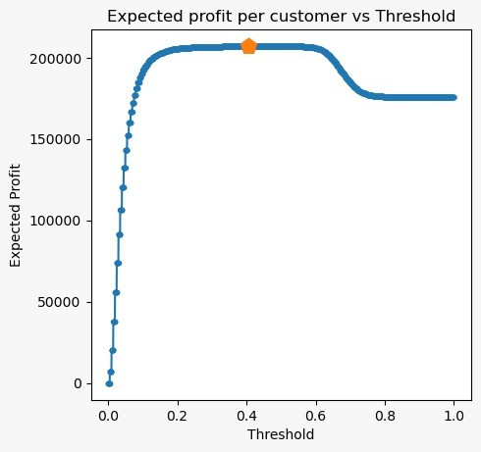
Visualizing Model Performance
Profit Curve
What is the optimal threshold?
Based on our analysis we recommend that the user picks a threshold of 0.4 to maximize their profit. This suggestion takes into account assumptions as stated.

Slide 12
Thank you for your attention!
Questions ?

